Slide 1
Investing: Analyzing Key Metrics
Understanding financial metrics for better investments
Notes:
AI-generated content may be incorrect. --- This presentation delves into the essential metrics used in investing to analyze companies. We will explore various financial ratios and metrics that investors use to evaluate company performance and potential investment opportunities.

Slide 2

Presentation Agenda
Understanding Key Metrics
Key metrics are essential for performing investment analysis and understanding market trends effectively.
In-Depth Ratios
We'll explore significant ratios such as PE, PS, and PB, which help assess a company's valuation.
Evaluating Opportunities
Learn how to evaluate investment opportunities by applying the discussed metrics in real scenarios.
Notes:
We will begin by understanding what key metrics are and their significance in investment analysis. Then, we will look in-depth at specific ratios such as PE, PS, and PB ratios. Finally, we will discuss how to evaluate investment opportunities using these metrics.

Slide 3

Understanding Key Metrics
Importance of Key Metrics
Key metrics serve as vital indicators of a company's financial health and overall performance, guiding investment decisions.
Assessing Company Performance
Investors need to understand key metrics to assess company performance effectively and identify profitable investment opportunities.
Evaluating Investment Opportunities
A solid grasp of key metrics aids investors in evaluating potential investment opportunities with higher accuracy.
Notes:
Key metrics are essential financial indicators that help investors assess a company's performance and make informed decisions. Understanding these metrics is crucial for evaluating investment opportunities effectively.

Slide 4

What is a Key Metric?
Definition of Key Metrics
Key metrics are essential quantitative measures for assessing a company's performance and financial health.
Importance for Investors
They provide critical insights that help investors make informed, data-driven decisions regarding their investments.
Areas of Insight
Key metrics focus on profitability, efficiency, and valuation, which are crucial for understanding company dynamics.
Notes:
Key metrics are quantitative measures used to evaluate a company's financial health and performance. They provide insight into aspects such as profitability, efficiency, and valuation, helping investors make data-driven decisions.

Slide 5

Importance of Financial Metrics
Standardized Comparison
Financial metrics offer a standardized framework for investors to evaluate companies across different sectors and industries.
Valuation Insights
Key metrics such as PE (Price to Earnings) and PS (Price to Sales) ratios assist investors in determining stock valuation.
Notes:
Financial metrics are vital for investors as they provide a standardized way to compare companies across industries. Metrics like PE and PS ratios help investors gauge whether a stock is overvalued or undervalued.

Slide 6

In-Depth Analysis of Key Ratios
Price-to-Earnings (PE) Ratio
The PE ratio is a measure of a company's current share price relative to its per-share earnings. It is commonly used to assess company valuation.
Price-to-Sales (PS) Ratio
The PS ratio compares a company's stock price to its revenues. It provides insights into how much investors are willing to pay per dollar of sales.
Price-to-Book (PB) Ratio
The PB ratio compares a company's market value to its book value, helping investors evaluate the relative value of a company's shares.
Notes:
In this section, we will explore specific financial ratios that are commonly used in investment analysis, including price-to-earnings (PE) ratio, price-to-sales (PS) ratio, and price-to-book (PB) ratio.

Slide 7

Price-to-Earnings (PE) Ratio
Definition of PE Ratio
The PE ratio is calculated by dividing a company's current share price by its earnings per share, providing insight into stock valuation.
Investment Indicator
The PE ratio indicates how much investors are willing to pay for each dollar of earnings, serving as a key investment metric.
Assessing Stock Valuation
The PE ratio is widely used by investors and analysts to assess the valuation of stocks and make informed investment decisions.
Notes:
The PE ratio is a valuation ratio calculated by dividing a company's current share price by its earnings per share (EPS). It indicates how much investors are willing to pay for a dollar of earnings and is widely used to assess stock valuation.

Slide 8

Price-to-Sales (PS) Ratio
Understanding PS Ratio
The PS ratio measures a company's market cap relative to its total sales, indicating its valuation efficiency.
Investment Insight
Investors use the PS ratio to assess how much they pay for each dollar of sales, guiding investment decisions.
Revenue-Generating Efficiency
A lower PS ratio may indicate better revenue-generating efficiency, while a higher ratio could suggest overvaluation.
Notes:
The PS ratio is calculated by dividing a company's market capitalization by its total sales or revenue. This metric helps investors understand how much they are paying for each dollar of sales, providing insight into the company's revenue-generating efficiency.

Slide 9

Price-to-Book (PB) Ratio
Understanding PB Ratio
The PB ratio is a financial metric that compares a company's market value to its book value.
Calculation Method
It is calculated by dividing the share price by the book value per share, providing insights into the stock's valuation.
Interpreting the Ratio
A lower PB ratio may indicate that a stock is undervalued compared to its assets, suggesting a potential investment opportunity.
Notes:
The PB ratio compares a company's market value to its book value, calculated by dividing the share price by the book value per share. A lower PB ratio may indicate that a stock is undervalued relative to its assets.

Slide 10
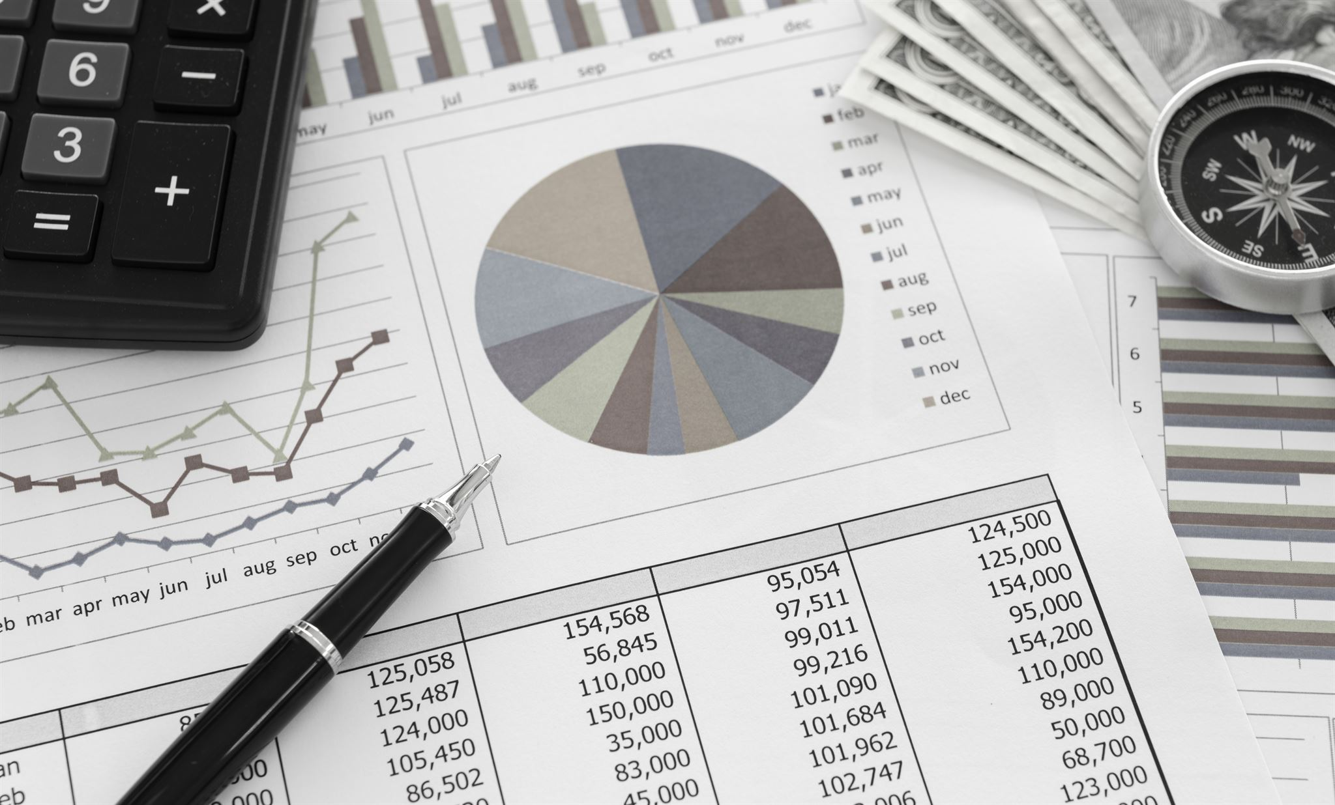
Evaluating Investment Opportunities
Understanding Financial Metrics
Analyzing financial metrics is crucial for evaluating investment opportunities effectively and making informed decisions.
Importance of Ratios
Key financial ratios guide investors in assessing the viability and profitability of potential investments.
Guiding Investment Decisions
Utilizing financial analysis can lead to sound investment decisions, minimizing risks and maximizing returns.
Notes:
In this section, we will discuss how to effectively evaluate investment opportunities by analyzing financial metrics. Understanding these ratios can guide investors in making sound investment decisions.

Slide 11

Comparative Analysis
Key Metrics Comparison
Comparative analysis focuses on key metrics to compare company performance against competitors or industry benchmarks.
Identify Strengths and Weaknesses
This analysis helps investors to pinpoint strengths and weaknesses in a company's financial performance, guiding investment decisions.
Notes:
Comparative analysis involves comparing the key metrics of a company with its competitors or industry averages. This approach helps investors identify strengths and weaknesses in a company's financial performance.

Slide 12

Using Metrics for Investment Decisions
Financial Metrics Importance
Financial metrics are essential tools that help investors assess the value and performance of stocks.
Informed Decision Making
Using financial metrics allows investors to make informed decisions about buying, holding, or selling stocks.
Industry Context
Understanding the context of financial metrics within the industry enhances investment strategies and effectiveness.
Notes:
Investors can use financial metrics to make informed decisions about buying, holding, or selling stocks. Understanding the context of these metrics within the industry can enhance investment strategies.

Slide 13
Conclusion
Importance of Key Metrics
Key metrics are essential in investment analysis as they help investors evaluate financial health and performance.
Understanding Financial Ratios
Familiarity with financial ratios like PE, PS, and PB enables investors to make informed choices about stocks.
Informed Investment Choices
Using key metrics effectively allows investors to assess companies and optimize their investment strategies.
Notes:
In conclusion, key metrics play a crucial role in investment analysis. By understanding and utilizing financial ratios such as PE, PS, and PB, investors can better assess companies and make informed investment choices.

